Slide 1
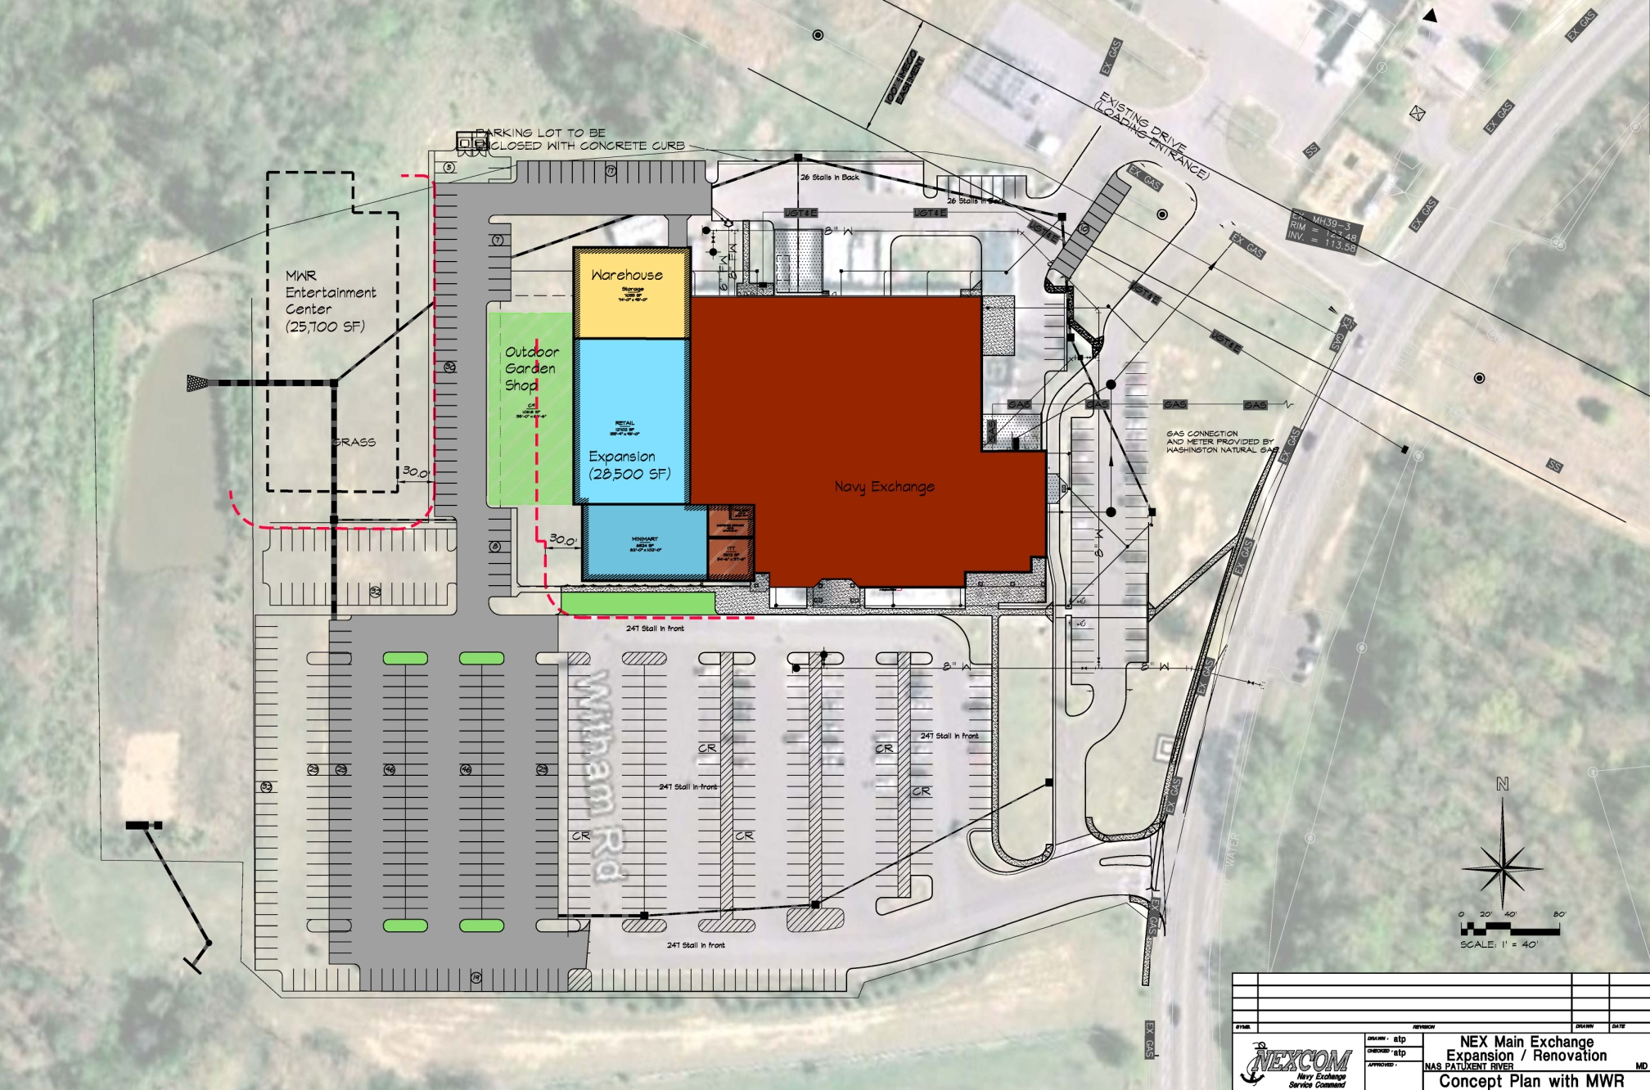
FY XXXX Main Exchange Expansion/Renovation
Project Description
Analysis of the design of facility: (For Example: This project renovates and expands the existing 7,983 square meter (85,900 SF) Shoppette, Building 504, by 15,662 square meter (168,559 SF). The new facility includes a main retail store, MCSS, food court including Anthony's, Robin Hood, Church’s, and Taco Bell. Concessions include a barber shop and optical shop. The project replaces a main exchange that is poorly configured and in need of repair, as well as consolidates all Exchange activities into one location).
Equipment Requirements: (For Example: While meeting the requirements for a public facility, the finishes, furnishings, fixtures, and equipment provide retail merchandise to authorized patrons).
Building Layout
Financial/Operational Performance ($K)
Planned Actual
Net Present Value: $3,660 $3,660
IRR 11.4% 11.3%
ROI: 11.8% 3.6%
Payback Period: 8.5 years 9.5 years
Design Cost: $1, 203 $1,210
Construction Cost: $9,700 $9,800
Equipment Cost: $ 2,937 $2,800
Project Cost: $ 13,840 $13,810
Actual Actual Actual
Planned Yr1 Yr2 Yr3
Sales: $21,934 $18,830 $19,080 $19,005
Expenses: $18,000 $20,000 $21,000 $20,000
Net Earnings/Income: $3,000 ($2,000) ($1,000) ($1,000)
* Net Earnings should include depreciation
Lessons Learned
What would you have done differently? (For Example: Reduced the scope of project).
What worked well? (For example: Customer feedback positive)
What did the project do for your revenue, expenses, and net earnings? (For example: It has a direct impact on the most basic calculations of the Exchange's value and profitability).
How did the project compare to your programming expectations? (For example: Improvements in building quality directly contributed to reducing the overall operational cost and increased satisfaction. The value for the money in construction requires completing the project on time, on budget and to a level of functionality that meets the determined needs. Sales were negatively impacted in first year by Tsunami).
* Goal is to make a better investment decision.

